Slide 1

TECH TYCOONS
Team Lead: Shivaani S
Team Members: 1.Mahima M
2.Sanjay C R
3.Sowmiya B
4.Pavithra Devi V

Slide 2
PROJECT TITLE
HISTODOOR
A Mobile and Web application for storage of the detailed medical history of the patient.

Slide 3
EXISTING PROBLEM
A person should carry a large number of existing medical reports to a hospital if they are in need for any further medications.
Even if a hospital is having any historyof a patient in their website who had any medical treatment in their hospital other hospitals cant view that data.
If patients lose their medical report , the recovery rate of it is very low.

Slide 4
PROPOSED SOLUTION
An app and website for storage of detailed medical report of a patient.
Any hospitals located in india can access this website and app and look onto their past medical history and can proceed with their further medication.
Hospitals can edit the report i.e. they can add on some recent medications on the report page of the individual while the patients have access only to read that report.
USP OF THE PROJECT:A Mobile and Web application, a single place where every individual’s medical report will be stored and whomsoever from anywhere in India can access it .

Slide 5
PROGRESS REPORT
Till now the base of the app and website is created.
Then login page is created and for a demo we had gathered 300 patients’ details from kaggle.
Aadhar number is created as an identity number for every individual.
Basic report accesses of the patients are created. For eg. Blood count data, sugar level, blood pressure data of the patients are added to report page in the app or website and we can access it.
We added some database to our app and website for accessing the history page with some extra medication details of the individuals.
Then at last we will gave access to the hospitals to edit and view and for the patients in read only mode of the medical report of individuals
We would further develop some facilities in those applications by adding much more details in the medication section.

Slide 6
PROGRESS REPORT
GITHUB LINK: https://github.com/Shivaani1011/Histodoor

Slide 7
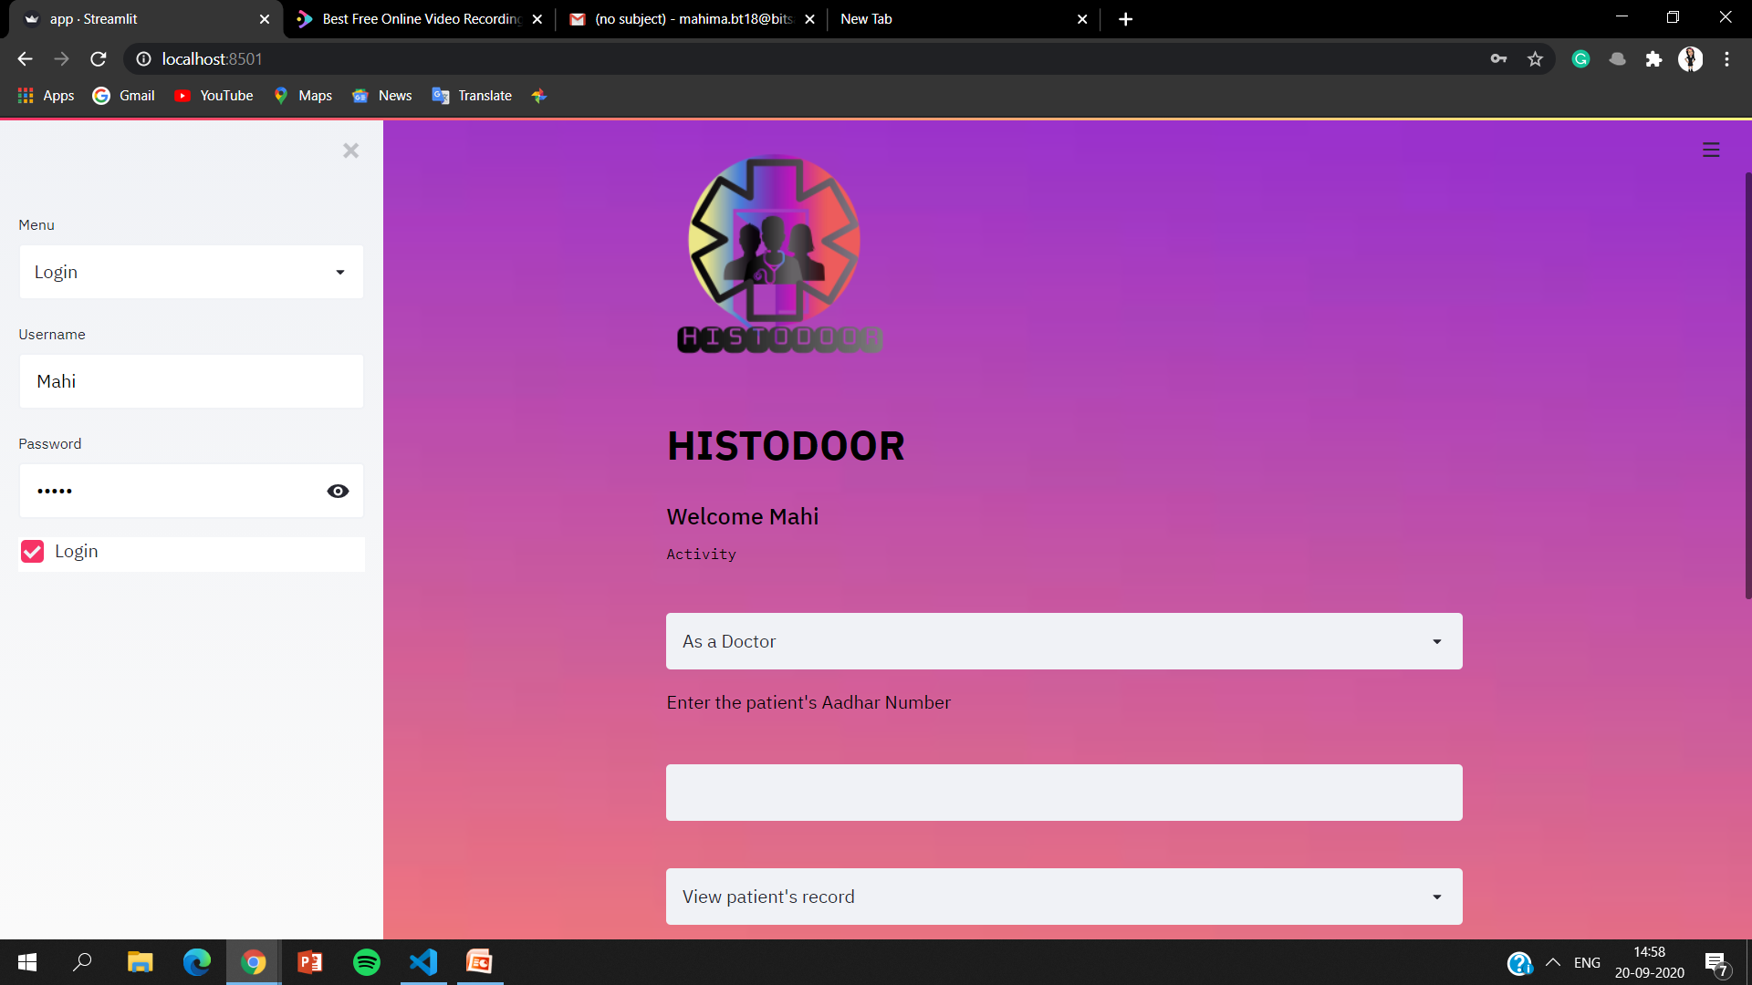
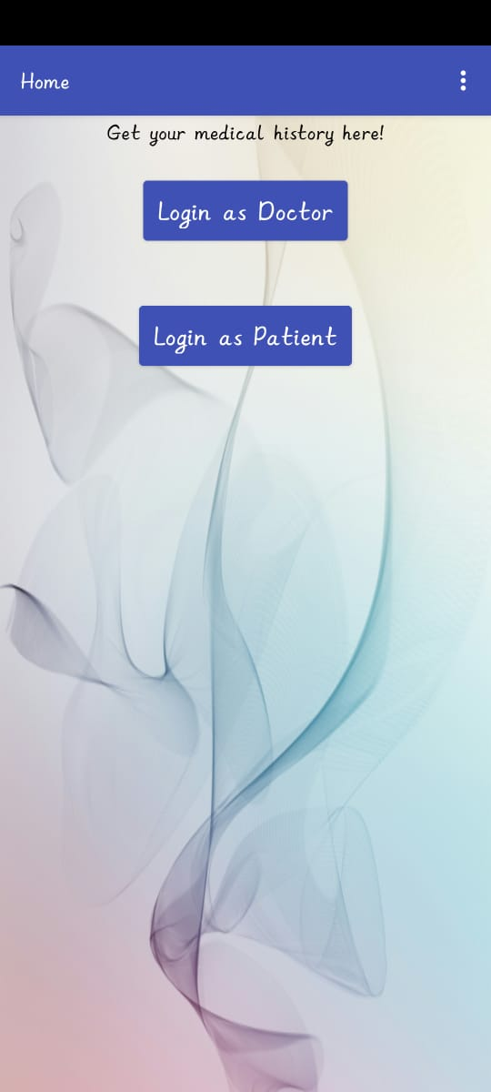
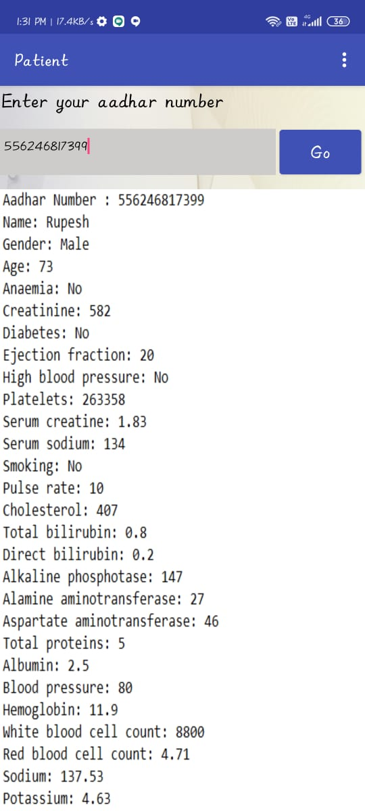
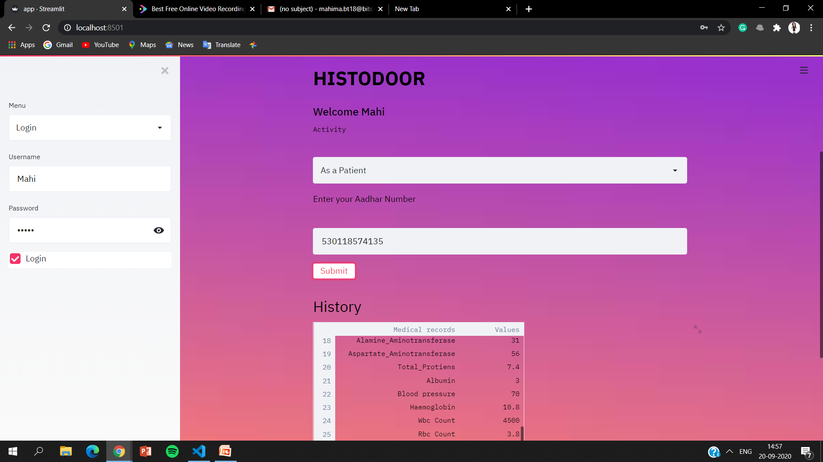
Mobile Application
Web
Application

Slide 8
THANK YOU

